Slide 1
Predicting bank Term Deposit Subscription
Ruixie Fang, Weidan He

Slide 2
Motivation
1. Interest: To build a model to predict whether a client will subscribe a term deposit or not .
2. Marketing demand:
The financial institution have a greater effectiveness for focusing on the potential customers “picked” by the model.
The customers would complain less about being bothered with irrelevant product calls.

Slide 3
Dataset Description
1. The project is based on dataset called Bank Marketing Dataset from UCI website (https://archive.ics.uci.edu/ml/datasets/Bank+Marketing#).
2. bank-full.csv with 45211 observations and 17 variables.

Slide 4
Data Processing
1. Data preprocessing
2. Model Selection and Evaluation
Logistic regression/ SVM/ Naive Bayes
Accuracy and ROC Curve
3. Conclusion

Slide 5
1. Data preprocessing
a. Missing data:
there are 3 categorical variables which contain “unknown” values.
Method:
built a two-by-two way contingency table compared our target response and the known/unknown status of attribute.
Applied chi-square test to check the significance to the response variable(Y).

Slide 6
1. Data preprocessing
b. Feature selection --- to drop the insignificant variables
Method: For the categorical variables,
Chi-square test to check the independence with Y
Method: For the numeric variables,
Pearson Correlation test

Slide 7

1. Data preprocessing
c. Imbalanced data
Method:
Performance measurement:
Accuracy and ROC(AUC)
Resampling method: Stratified Cross Validation

Slide 8
Stratified cross validation
Split data into two parts: training set and test set
By createDataPartition ( ), with percentage P=0.7.
The mean respond value is approximately equal in all the folds.
Each folds contains roughly the sample proportions of the types of class labels.

Slide 9
2. Model Selection and Evaluation
 | Logistic regression | SVM | Naive Bayes
Accuracy | 0.8997 | 0.8959 | 0.8756
AUC | 0.904 | 0.619 | 0.720
Logistic regression!!
It has the most powerful prediction ability.

Slide 10
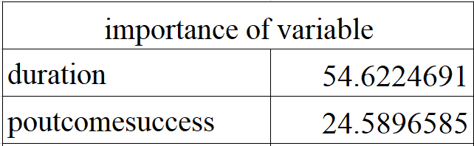
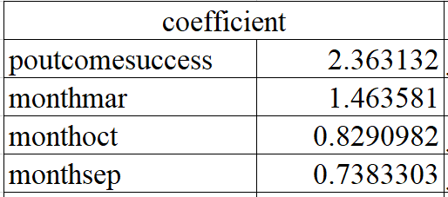
3. Conclusion
Most Significant factors:
Duration / Outcome of the previous marketing / Month
Recommendation:
if banks want to improve campaign efficiency, they should improve the quality of conversation on the phone and focus on the potential clients, and follow the good timing to run their campaigns.

Slide 11
Thank you!

